Slide 1

Art/Srj
Rebecca Hollidge- c00300511
Sophia Stanley – c00299461
Jasmin Suter - c00301545

Slide 2

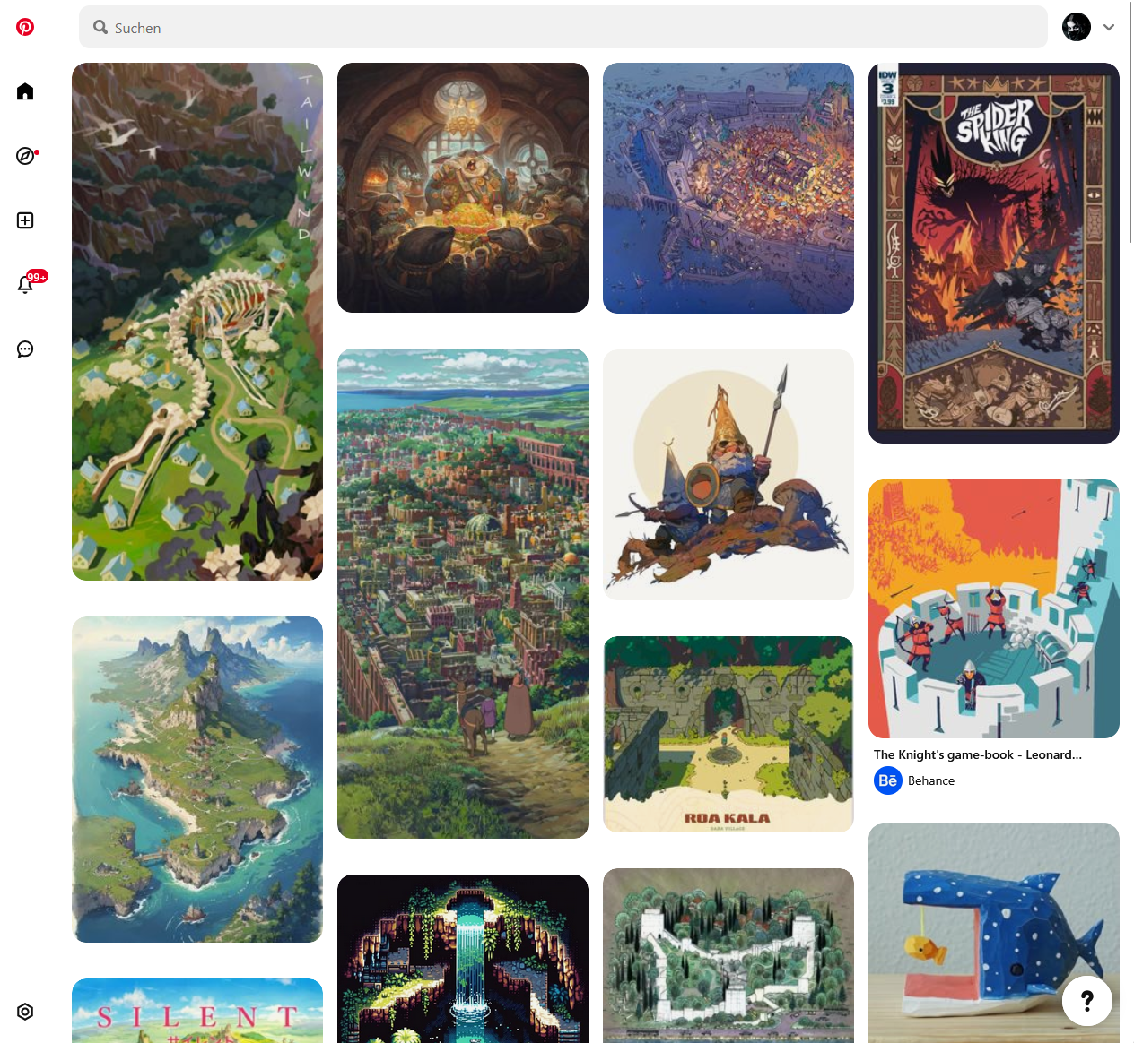
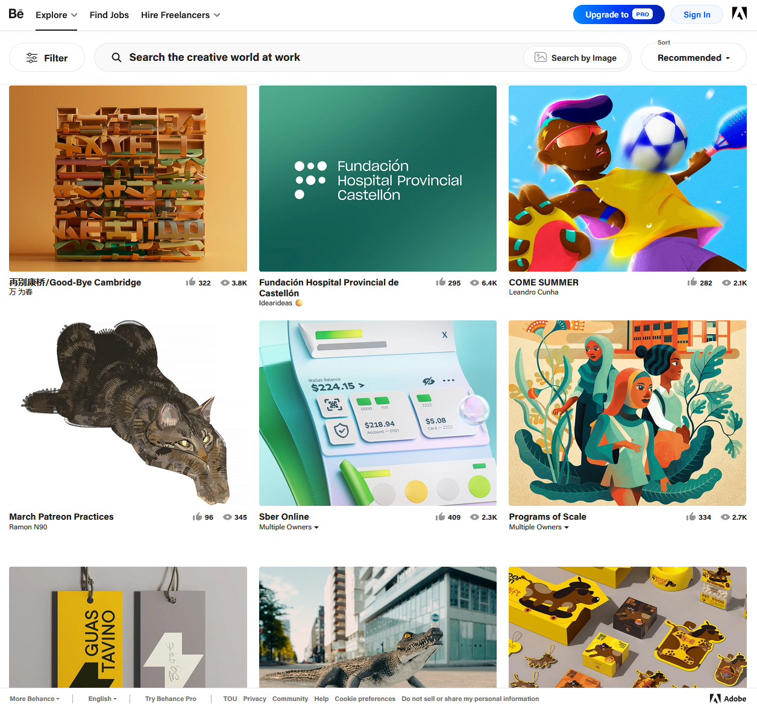
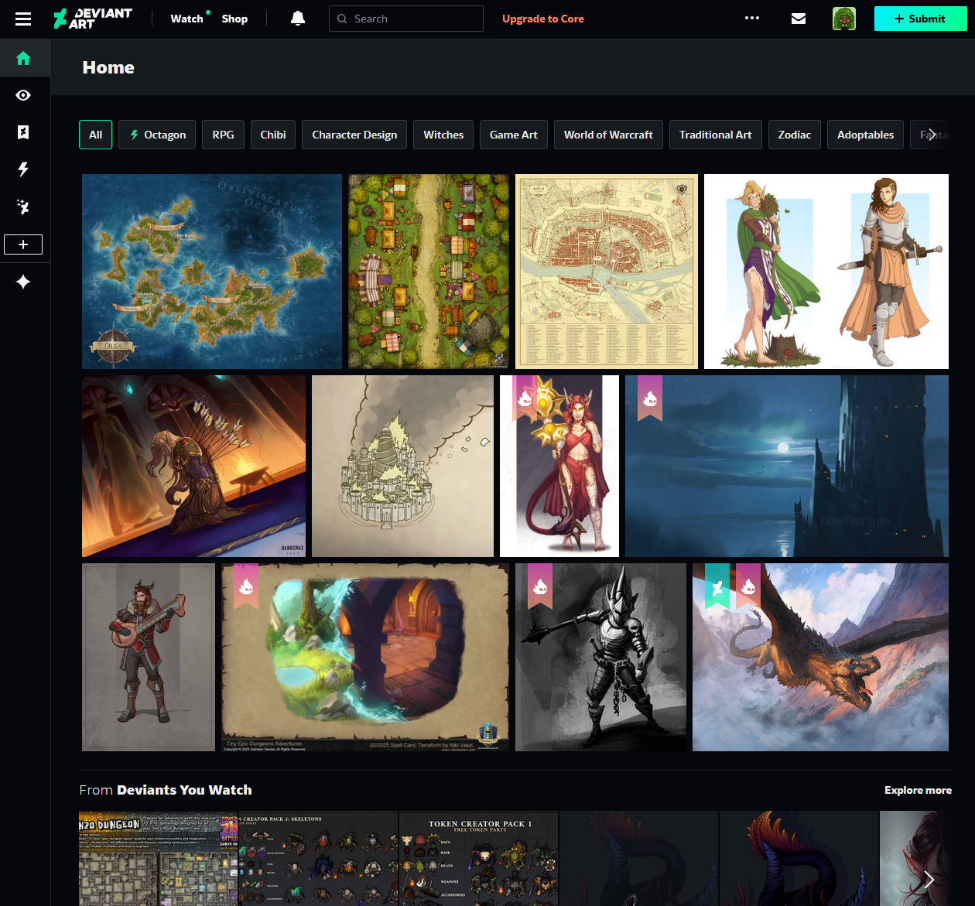
Initial Research
Pinterest
Behance
DeviantArt

Slide 3
Main Insights
Visible header with clear navigation
Focus on images through simple background
Black and White + Highlight colour
Highlight important features
Grid pattern for art

Slide 4
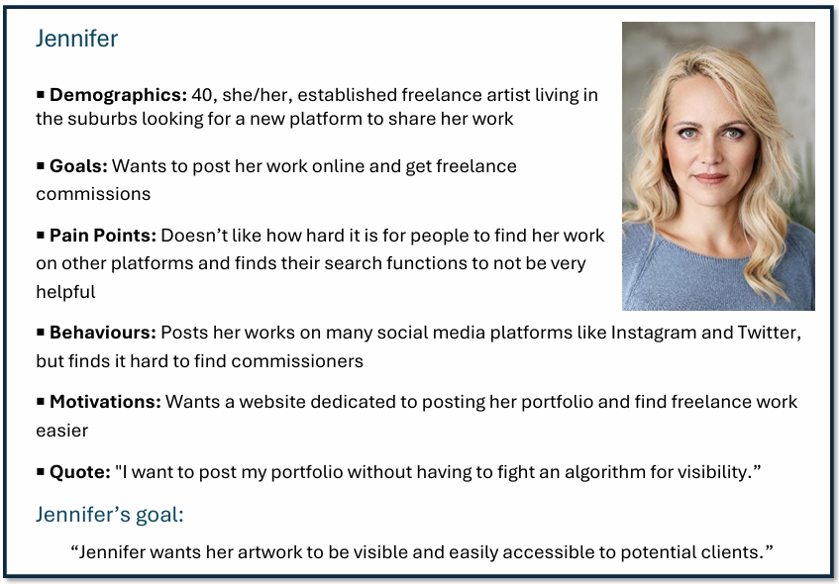
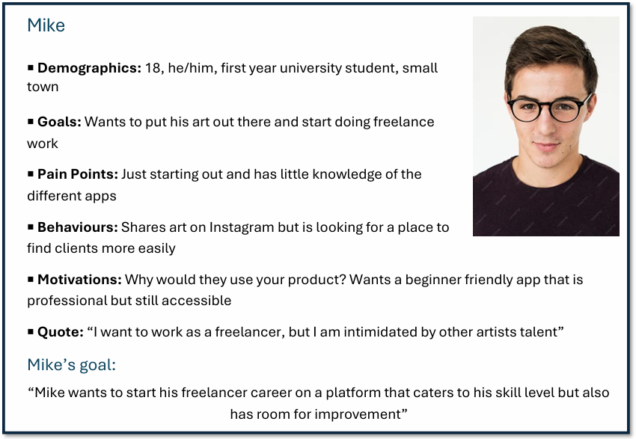
Audience Insights
3 Personas
Artists looking to get commissioned
Pain Points
Difficult to find specific images or artists
Organization and quality depends on users
Focus on AI instead of artists
Difficult to get noticed

Slide 5
Our goals
Share art | Browse Art | Find Artists
Allow users to organize their own content
Make it easy to get commissions
Provide easy to navigate search feature

Slide 6

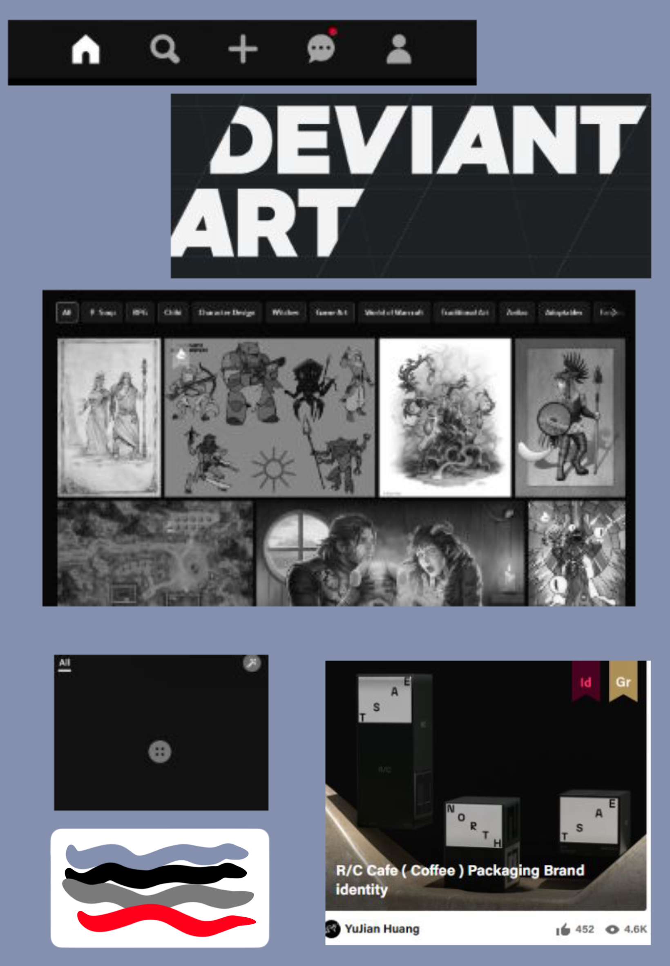
Drawing sketches and choices
The Beginning of
Art/srj

Slide 7
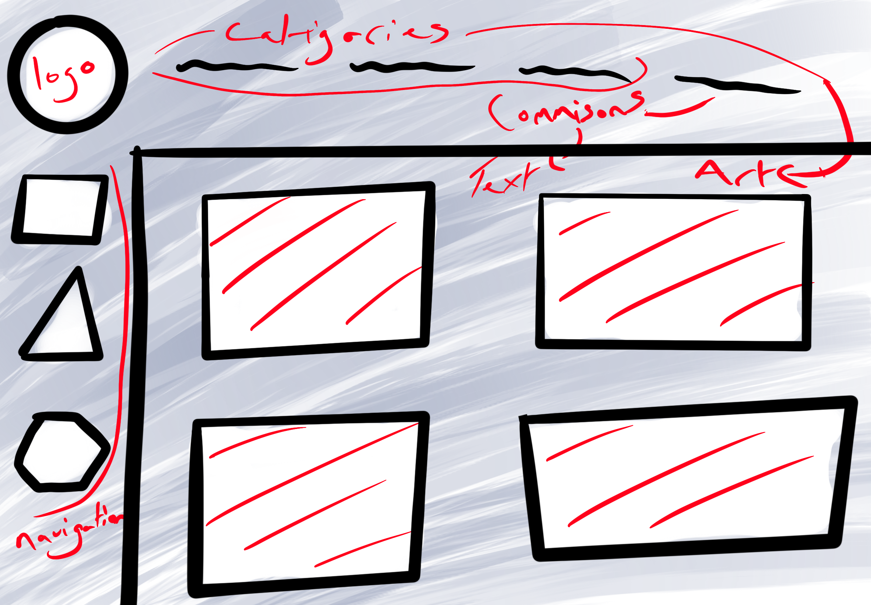
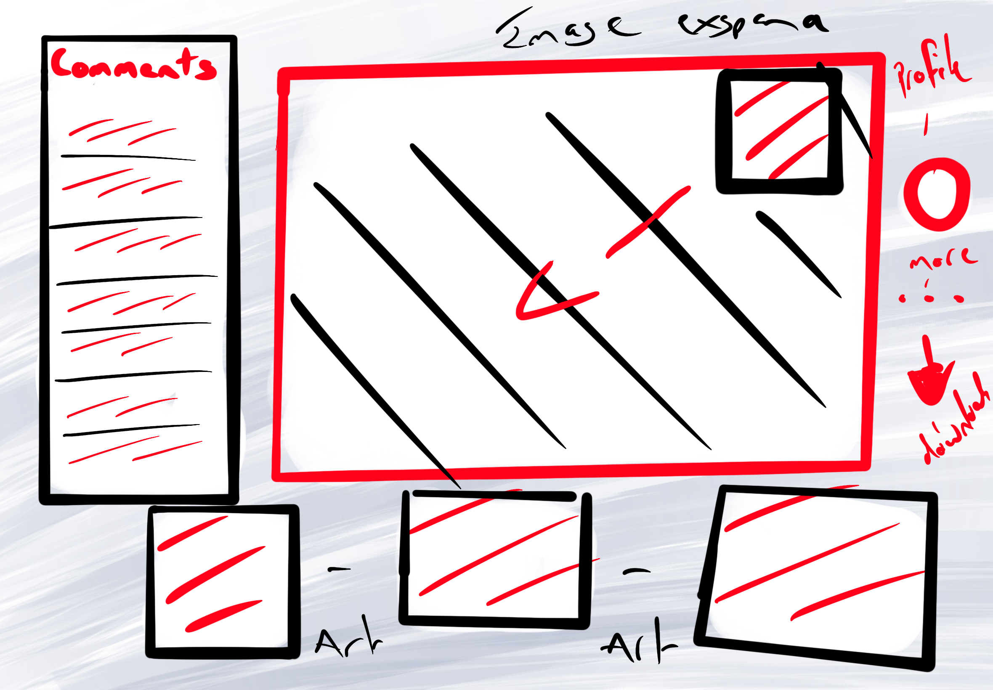
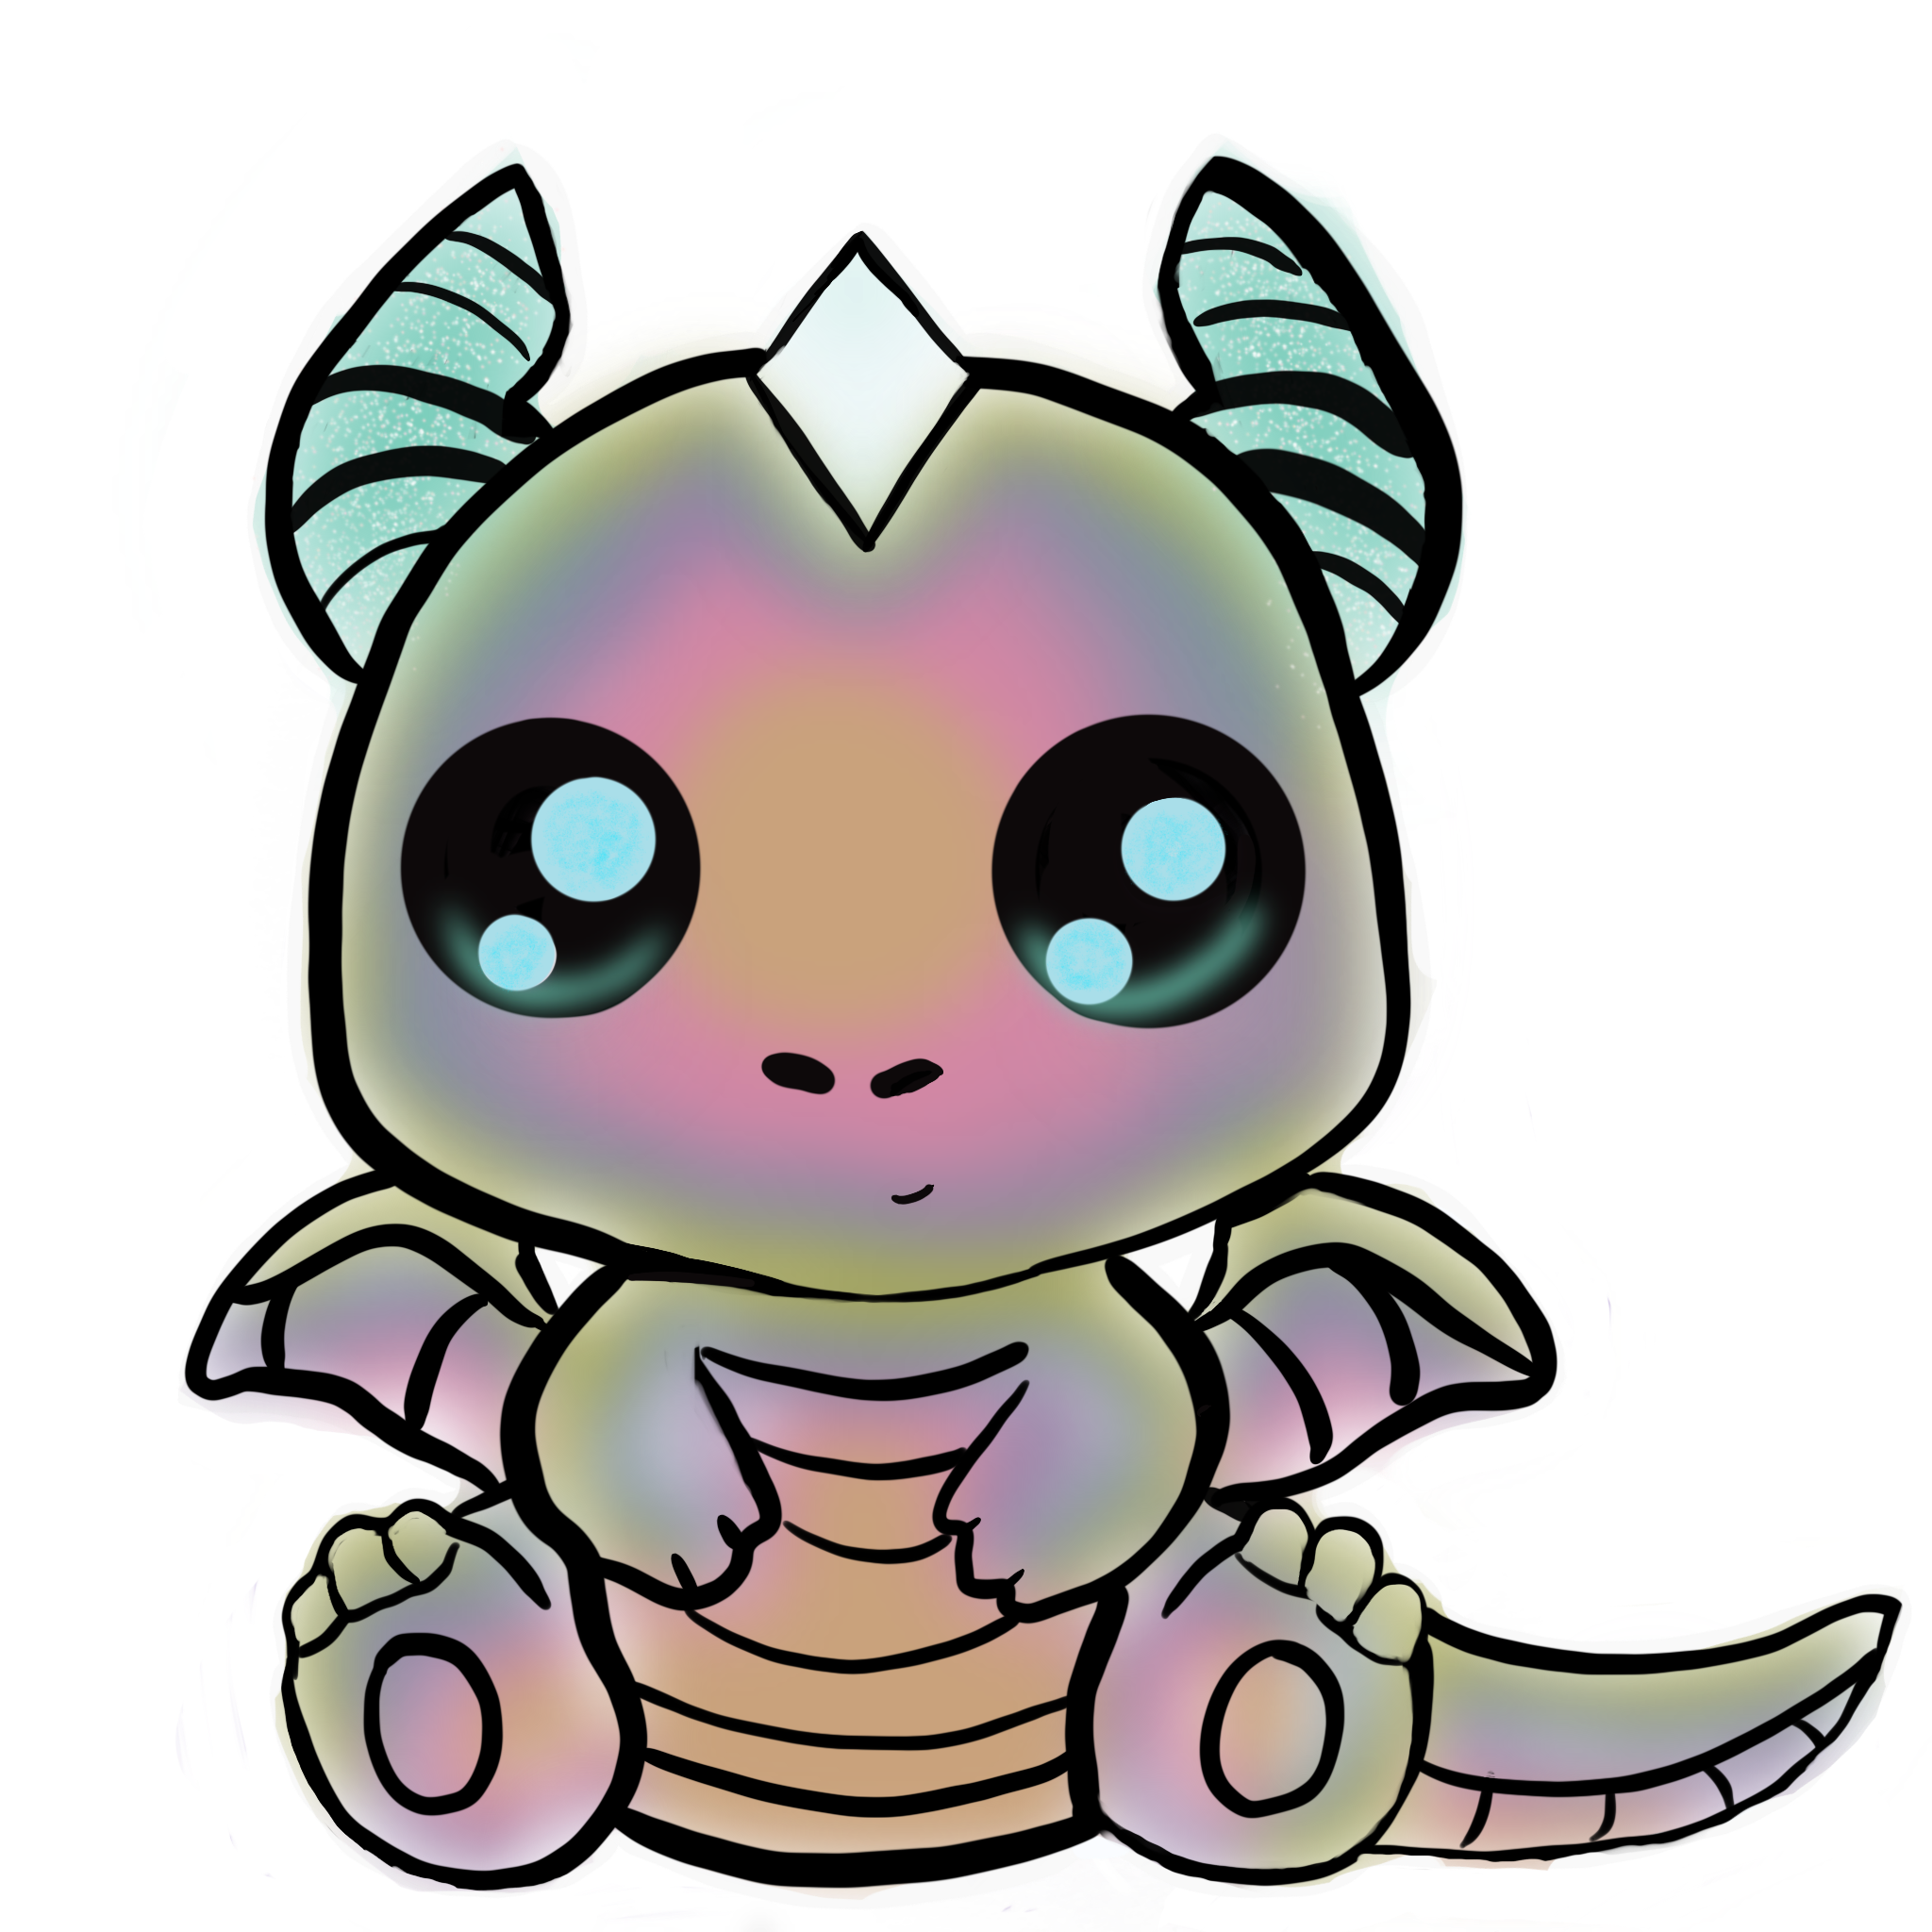
Main page
Expanded image

Slide 8
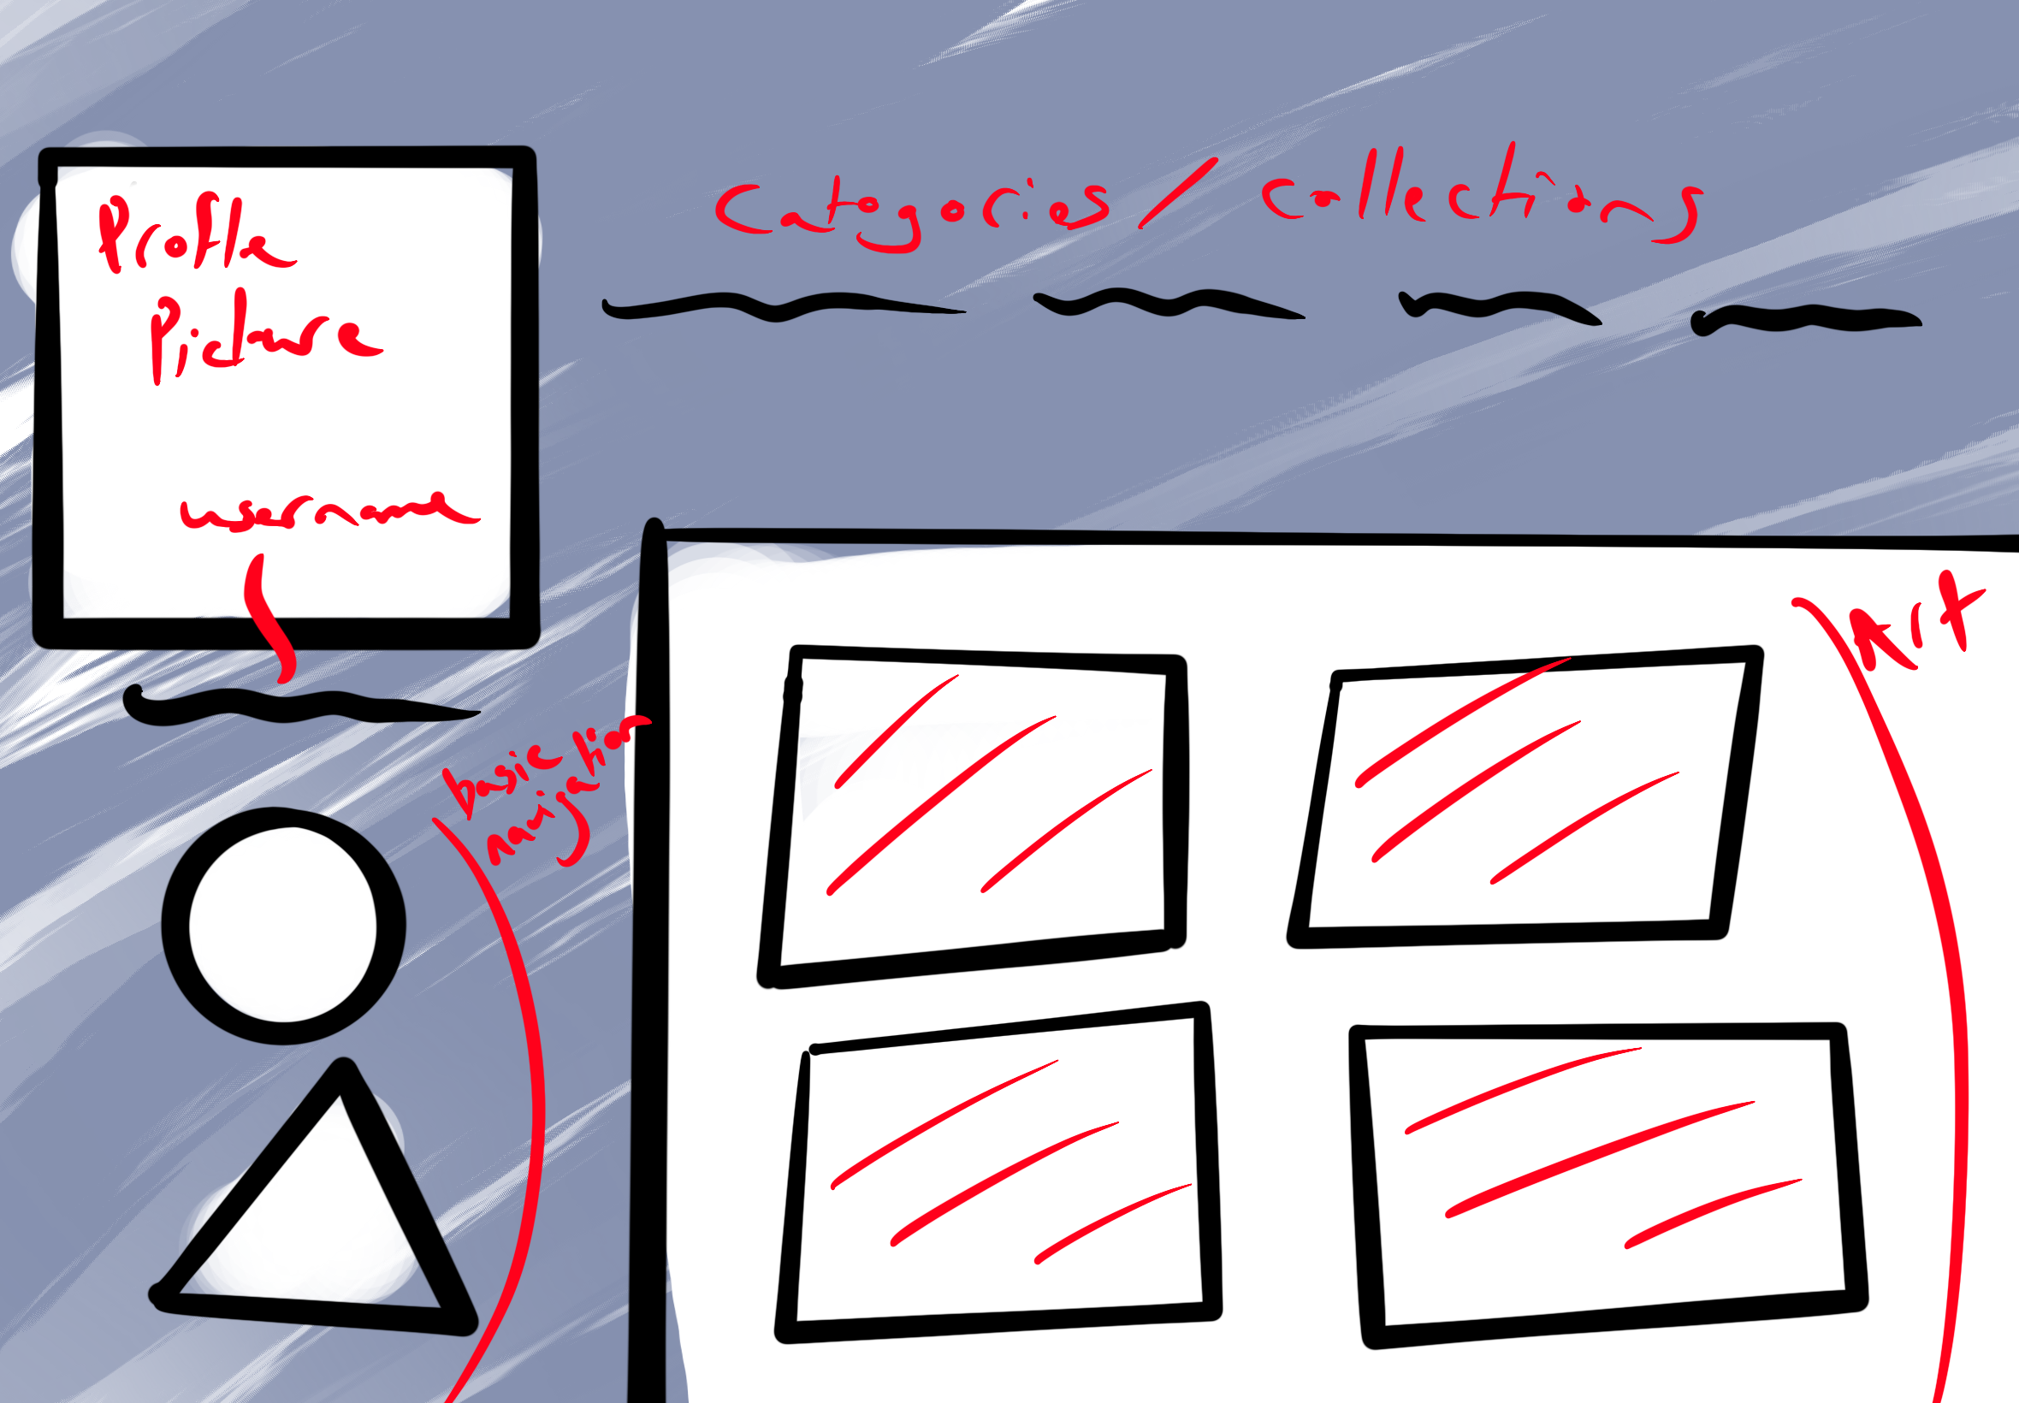
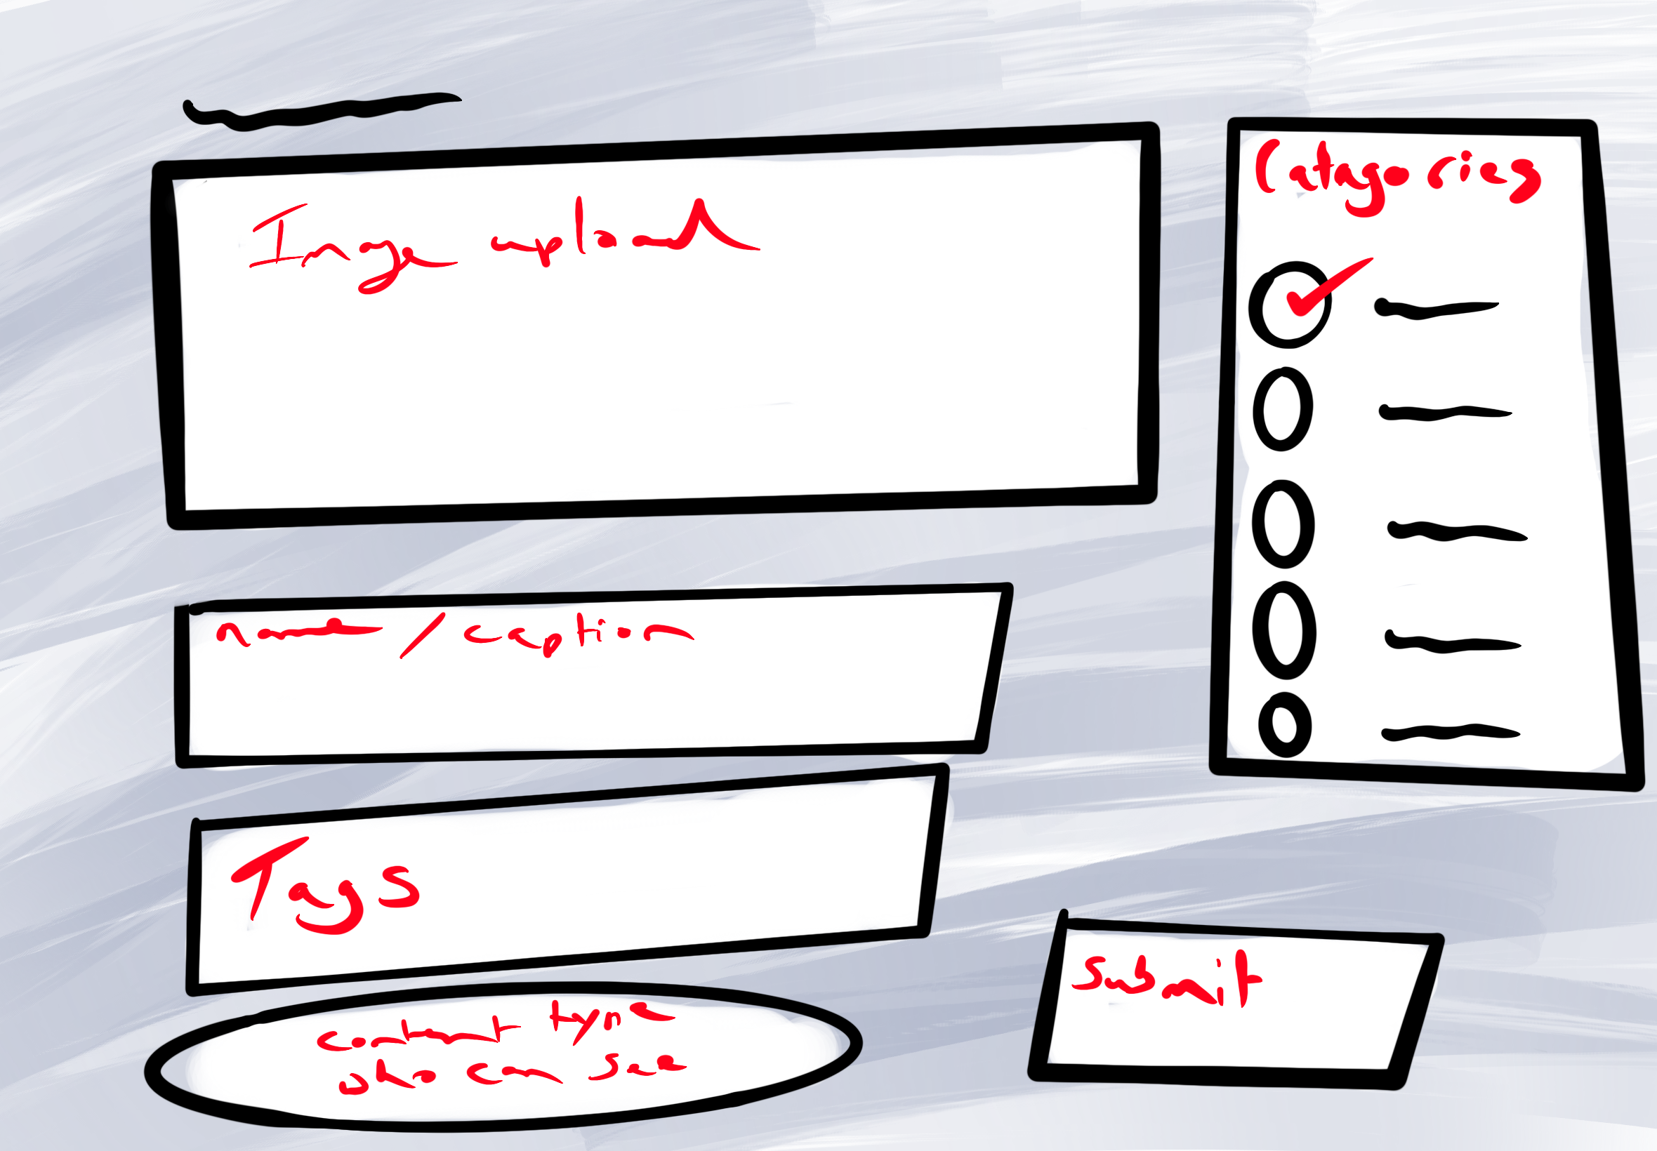
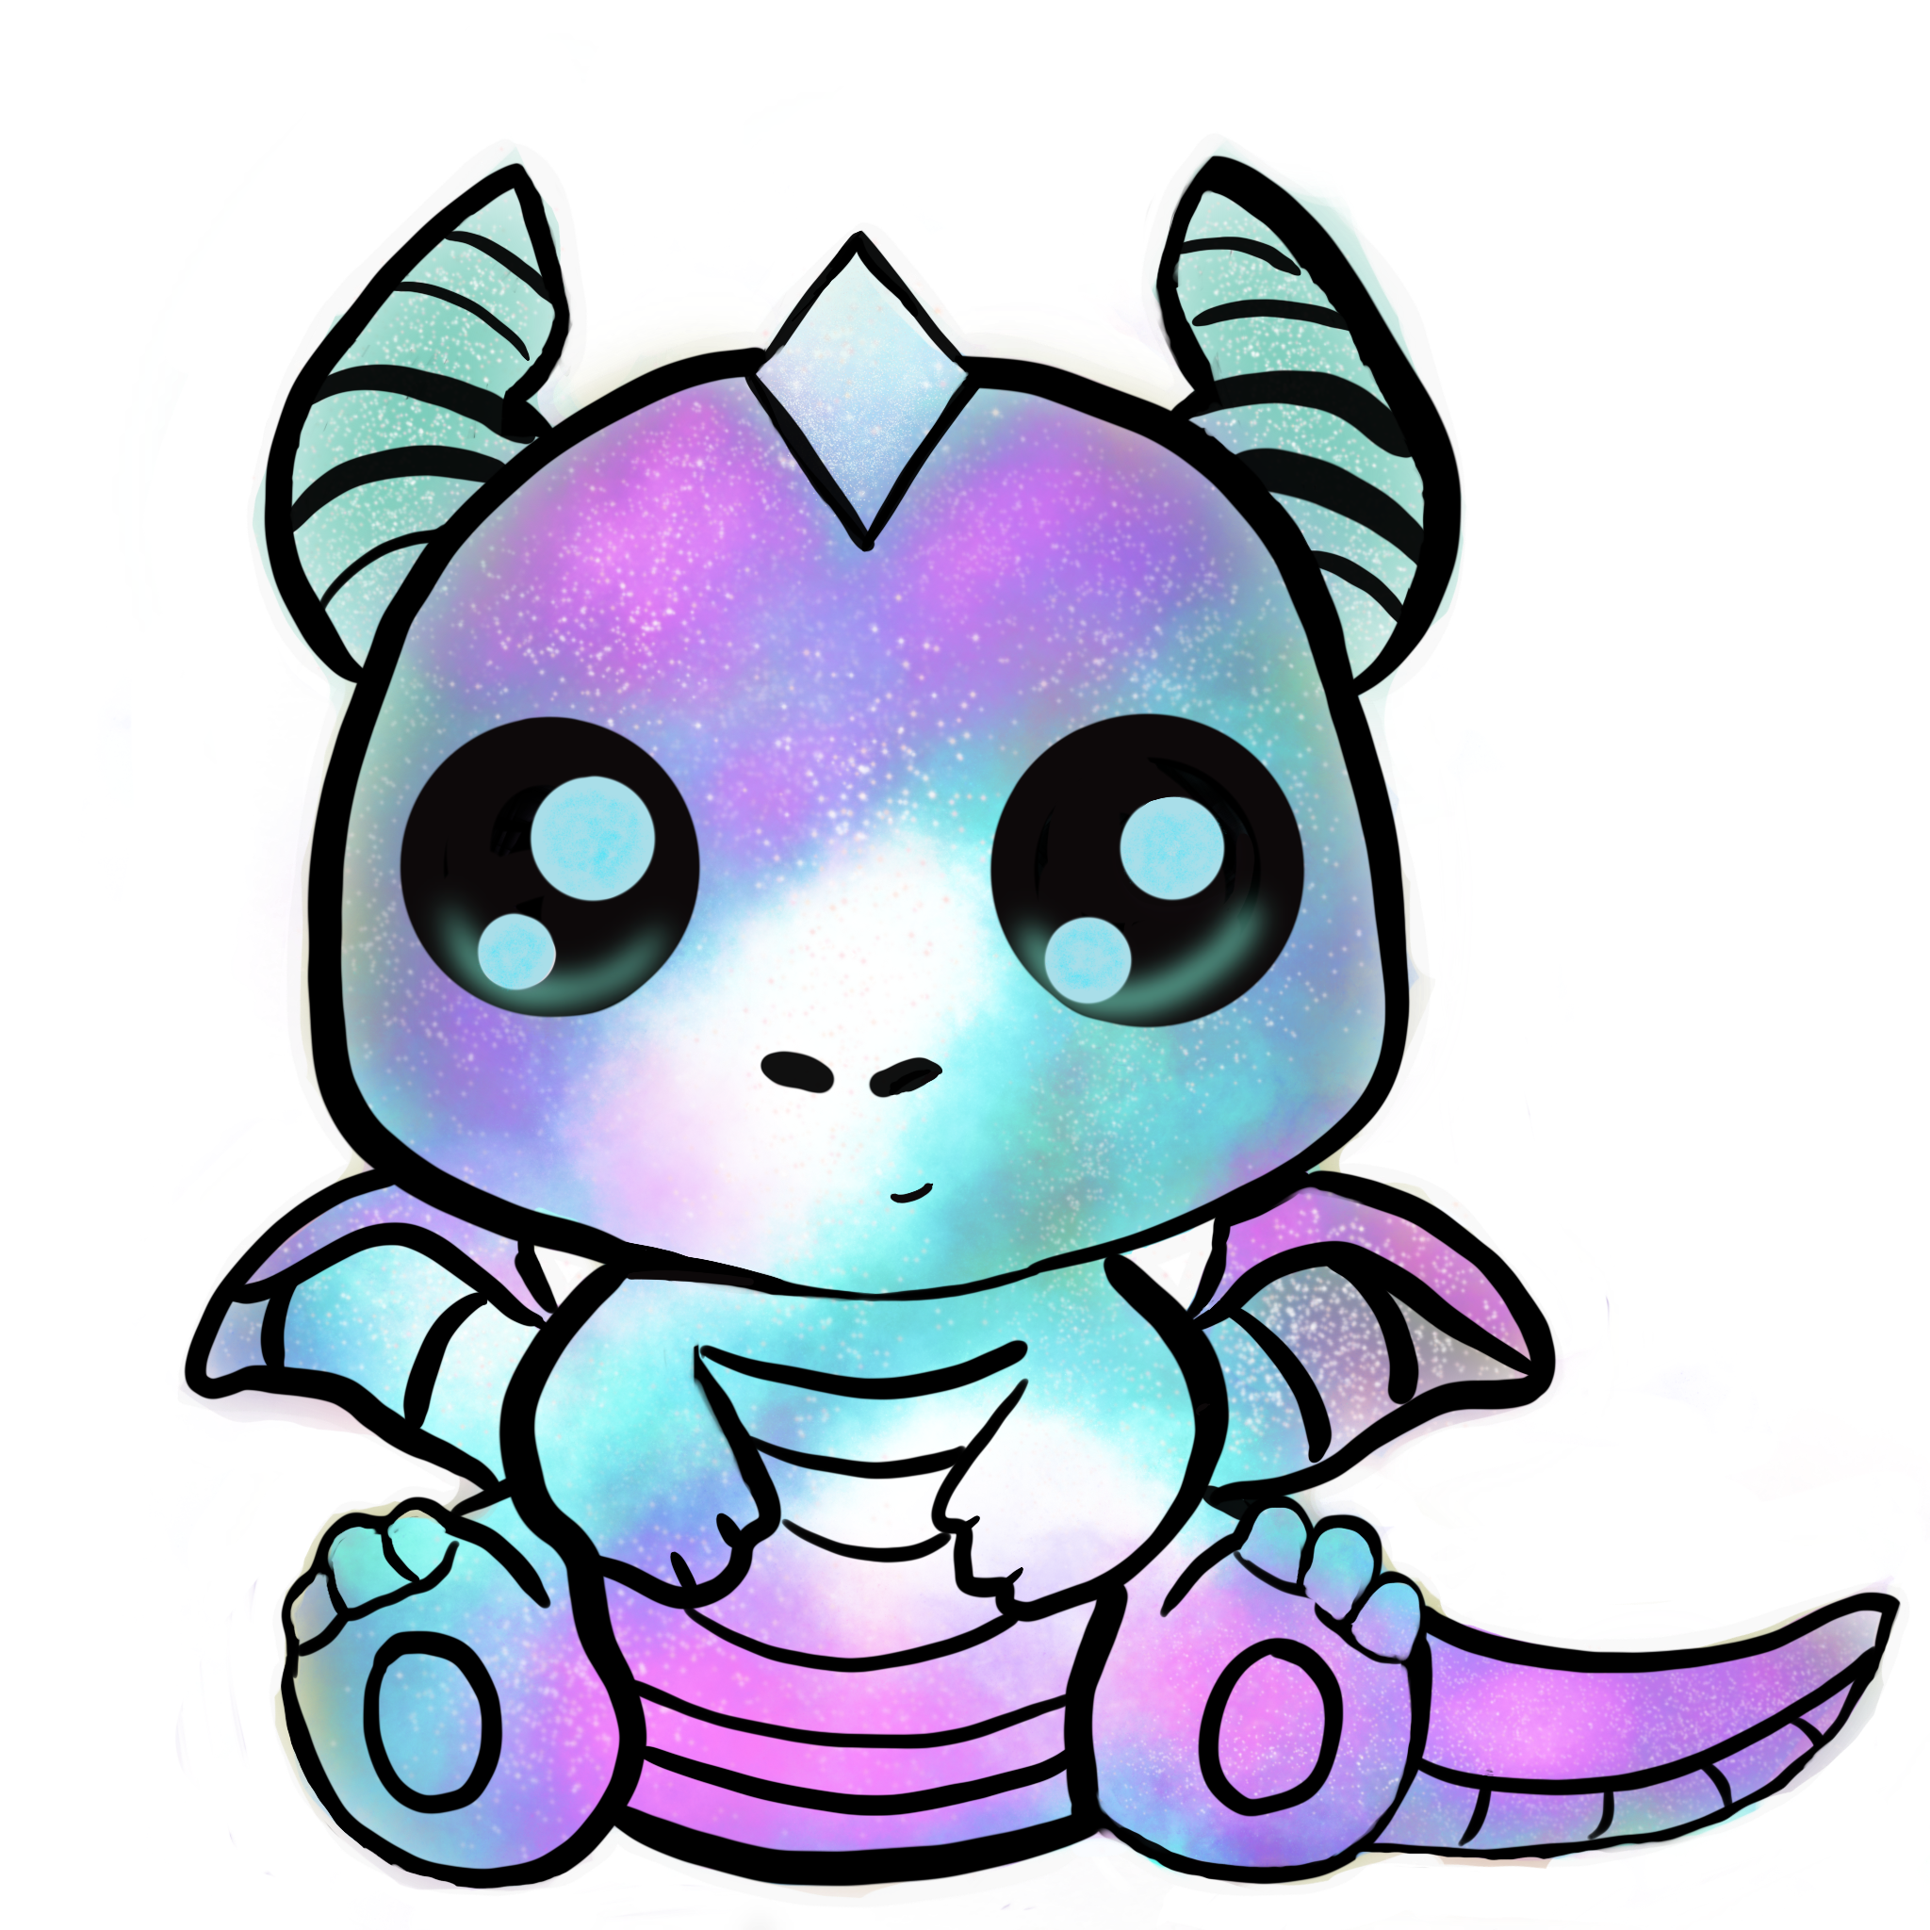
profile
Upload page

Slide 9

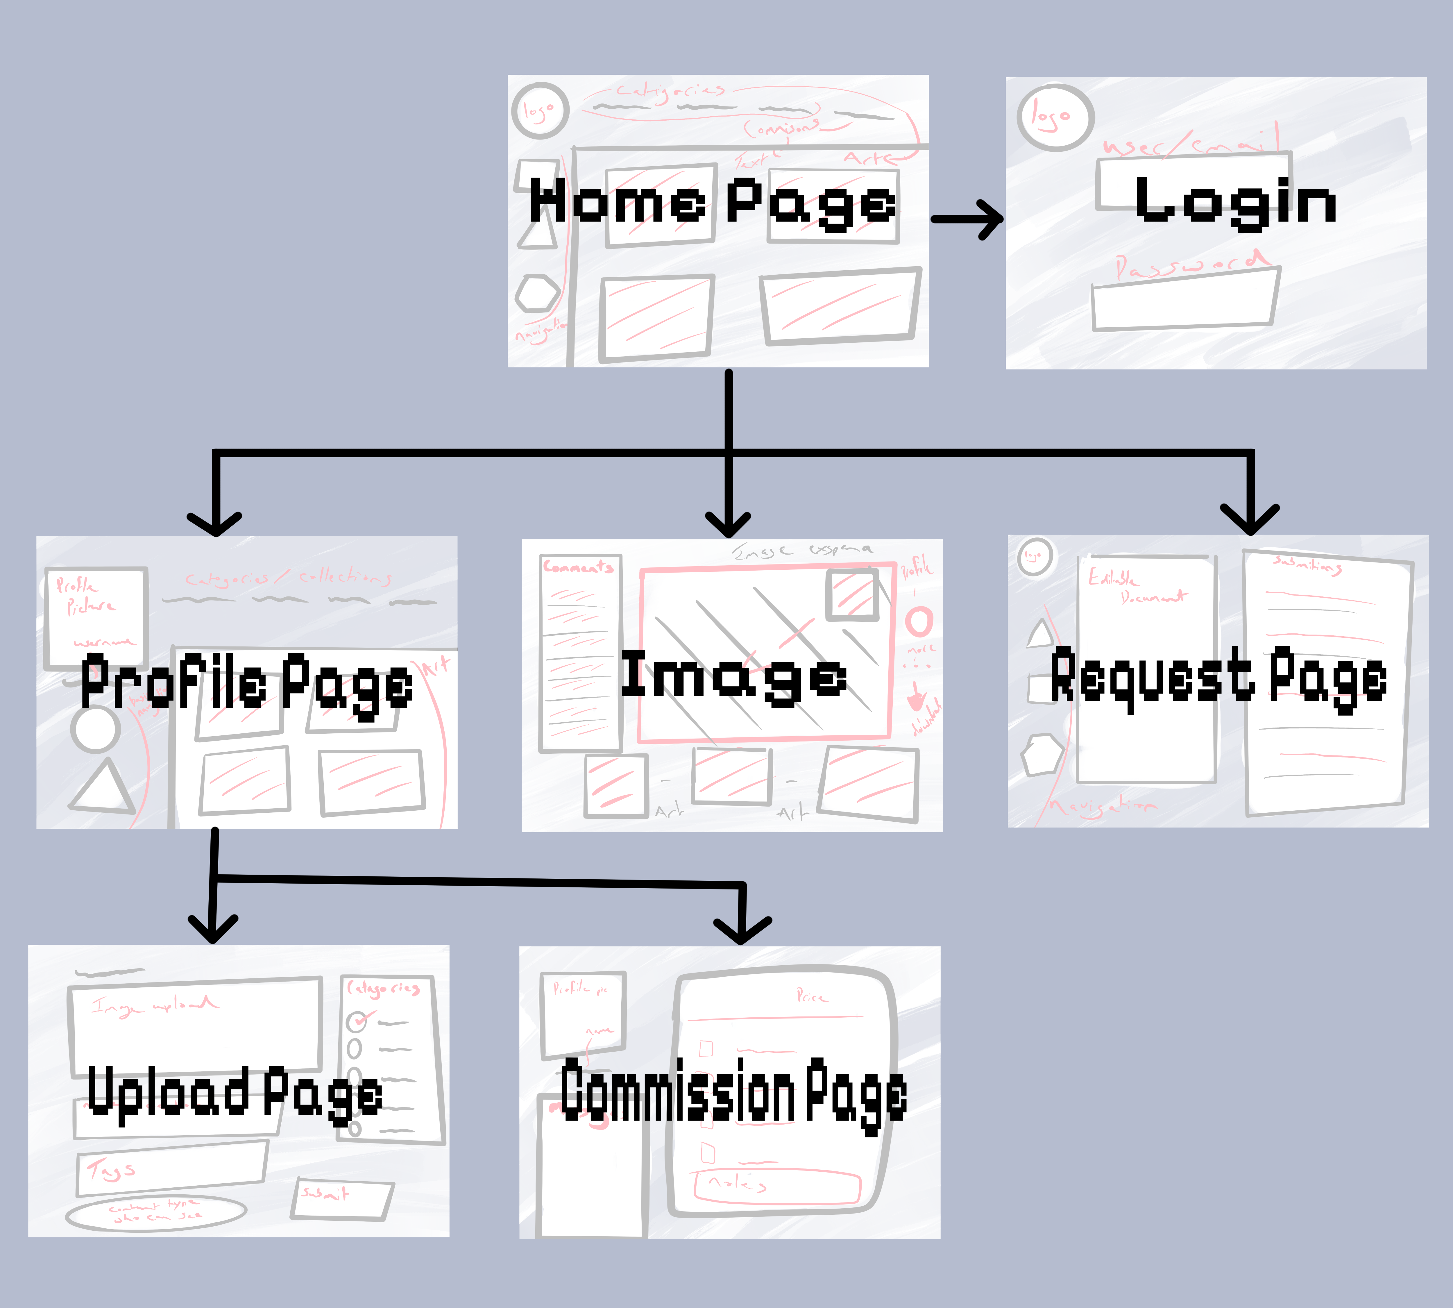
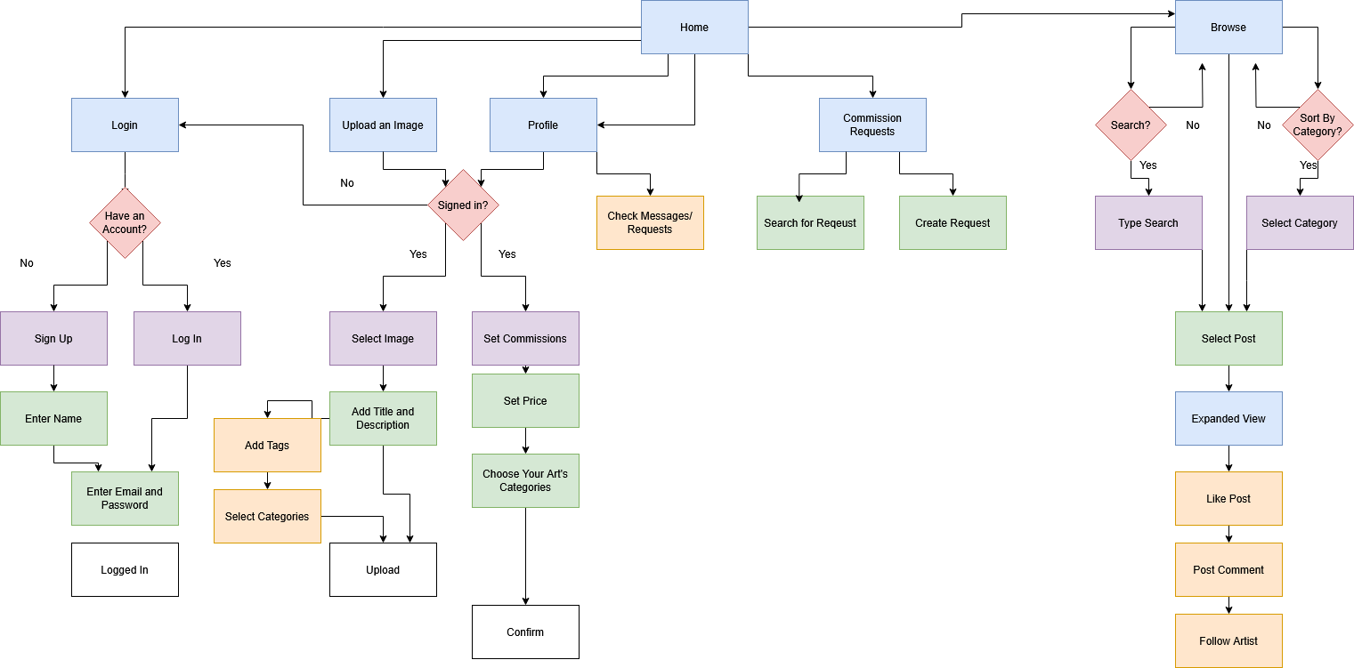
Site Map & User Flow

Slide 10

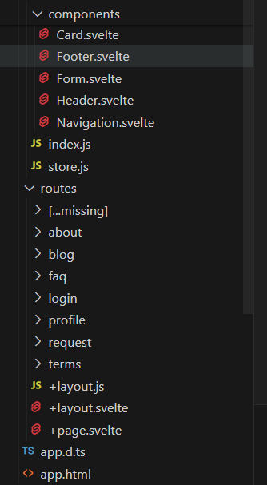
Developing the Website
9 Pages
3 pages each
Rebecca: Home, About, Error
Jasmin: Profile, ToS, Blog
Sophia: Login, Requests, FAQ
Background image: vecteezy.com

Slide 11
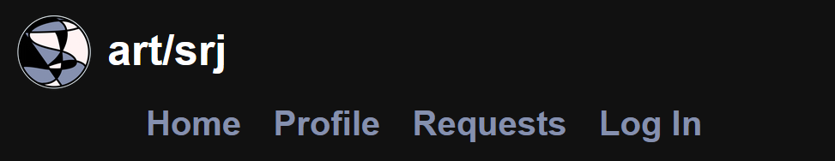

Responsiveness
Background image: vecteezy.com

Slide 12
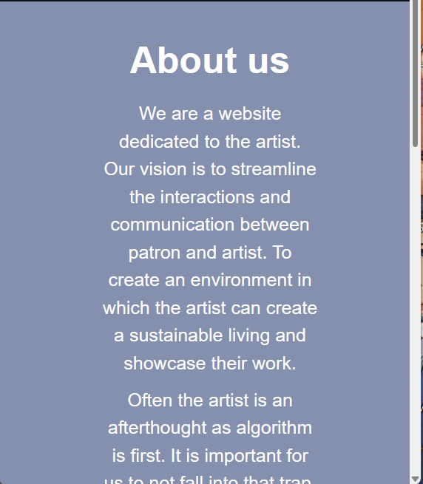
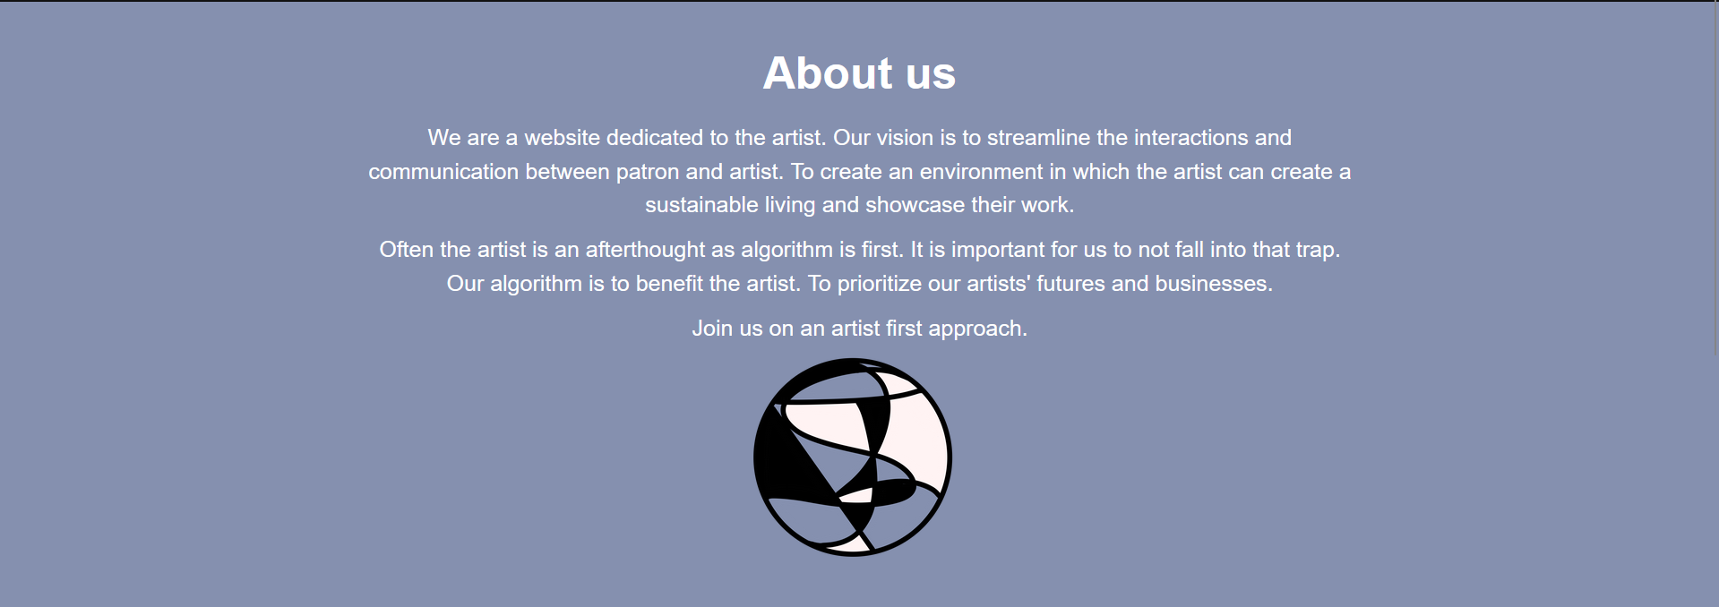
Text resizing

Slide 13
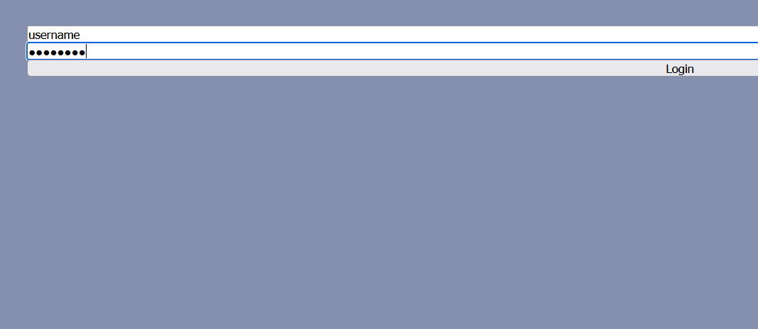
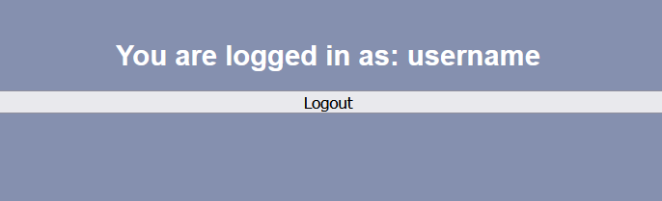
Logging in

Slide 14
Testing What We Learned
Development build
Resizing browser
Testing inputs on login
Layout and design of website
Using % or vh/vw instead of px
Login feature needs to be fixed

Slide 15
Future Steps
Dynamic pages
Finalizing pages
Finishing touches
Building website

